Slide 1
GEOG788P Project Update 2
Natalie Memarsadeghi

Slide 2
Recap of Goals
Create an animated storm runoff visualization
Calculate runoff velocity and volume
Site: Upstate NY, Storm event from Oct.3- Oct.5

Slide 3
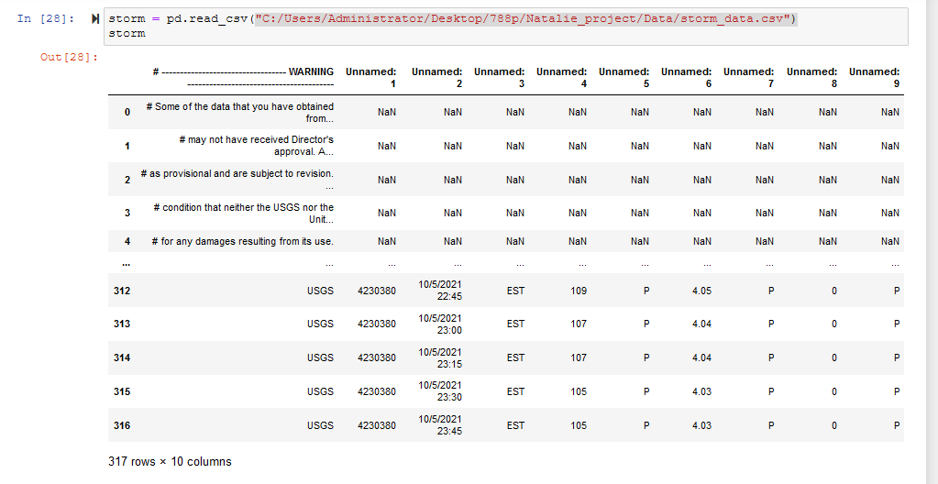
Load and Clean up Data
Notes:
Data is pretty messy initially, doesn’t start until line 28 and a lot of unnecessary data

Slide 4
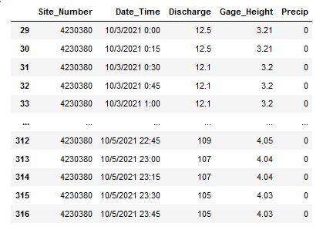
Notes:
Removed unnecessary lines, renamed columns, deleted unnecessary data

Slide 5
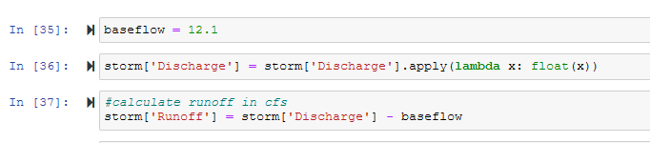
Calculated Runoff Volume
Notes:
Calculate runoff in cfs

Slide 6

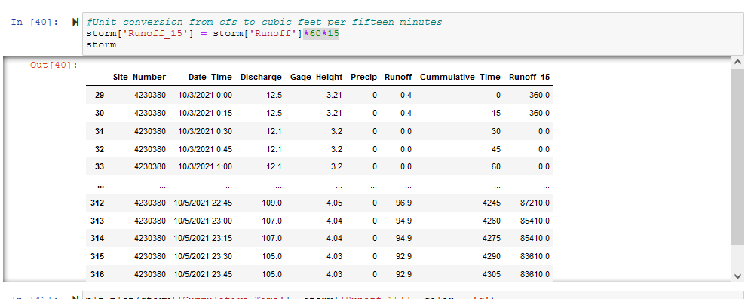
Notes:
Calculate time passed since start of storm, convert runoff to cubic feet

Slide 7
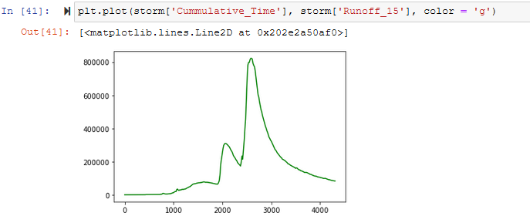

Slide 8
Calculate Runoff Velocity
Using the rational method
Q = ciA
Where Q is runoff velocity (cfs), c is rational runoff coefficient (determined by land surface type), i is average rainfall intensity (in/hr), and A is drainage basin area

Slide 9
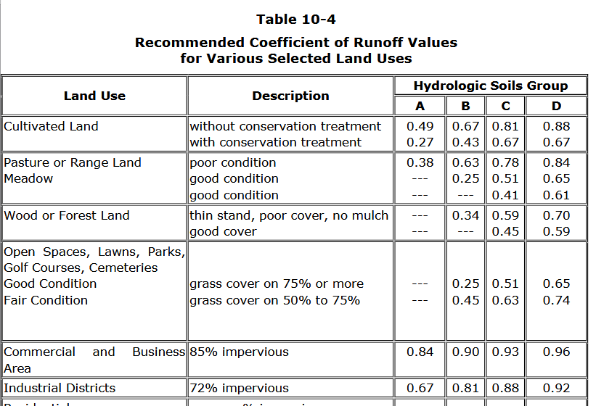
Notes:
NJ DOT Planning Manual

Slide 10
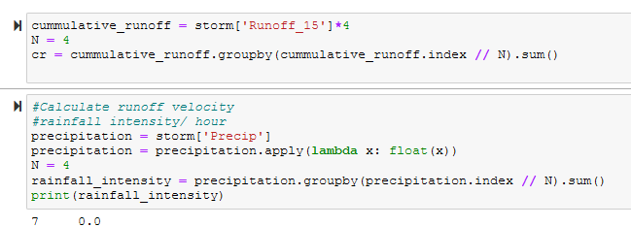

Slide 11
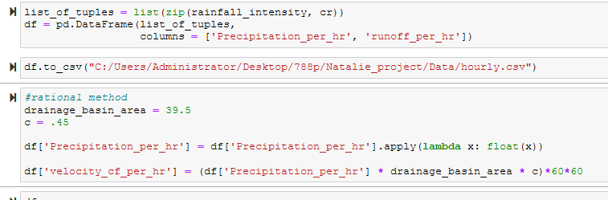

Slide 12
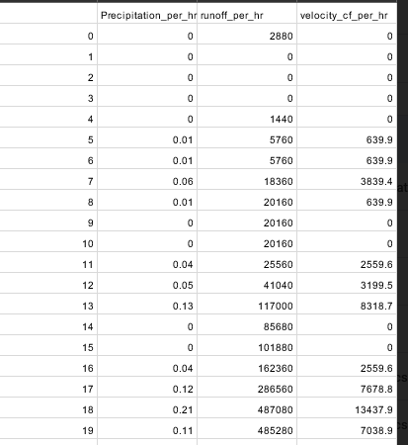

Slide 13
Plan for Visualization
Create gif
73 hours during the rain event, loop to create 73 maps
Size of rain visualization is based off velocity, and color is based off volume
Create in loop:
Shapefile of size that corresponds to velocity column using dem pixels

